Slide 1
Reading Group
Nightcore: Efficient and Scalable Serverless Computing for Latency-Sensitive, Interactive Microservices
ASPLOS21’
Authors: Zhipeng Jia， Emmett Witchel
2021/10/11
Presenter: Tianyang Niu

Slide 2
Outline
1
Background
2
Motivation
3
Design
4
Evaluation
3
5
Conclusion

Slide 3
Outline
1
Background
2
Motivation
3
Design
4
Evaluation
3
5
Conclusion

Slide 4
Background
Repair
Repair for Different Codes

Slide 5
Background
Repair
Degraded Read
Time
repairing and transferring can be pipelined
transfer time plus the repair time of the first chunk(原因是修复比传输快？)
Recovery
recovery efficiency
disk bandwidth

Slide 6
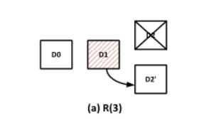
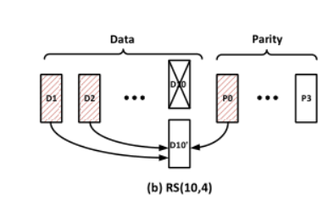
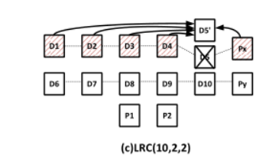
Background
Repair for Different Codes
Replication
Repair for RS code
Repair for LRC codes

Slide 7
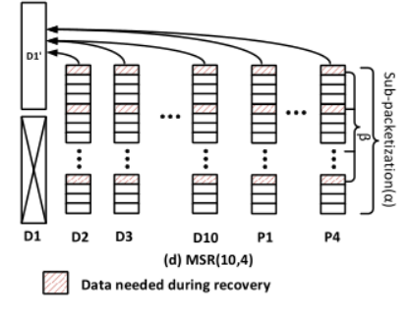
Background
Repair for Different Codes
Repair for Regenerating codes

Slide 8

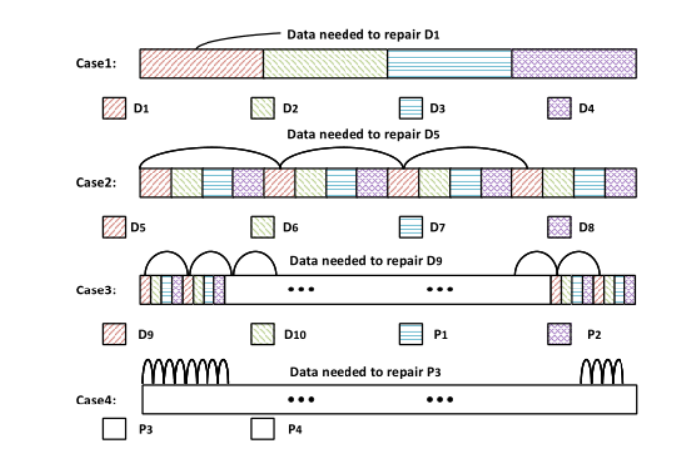
Background
Repair for Different Codes
Repair for Regenerating codes
（10，4）α=256，β=64
（s0,s1,s2,s3）

Slide 9
Background
Repair for Different Codes
Repair for Regenerating codes
（10，4）α=256，β=64
（s0,s1,s2,s3）

Slide 10
Outline
1
Background
2
Motivation
3
Design
4
Evaluation
3
5
Conclusion

Slide 11
Motivation
Target
low degraded read time
high recovery efficiency

Slide 12
Motivation
Chunk Size
Large
Small

Slide 13
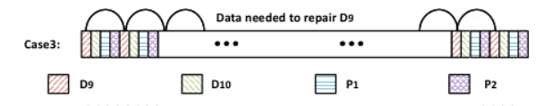
Motivation
Chunk Size
Large
256KB, sub-chunks size 1kb
Repair Need to read 64 sub-chunks
I/O size is 4KB(SSD)
read amplification
Solve
chunk size is as large as 1MB
HDD
I/O size as large as 4MB(chunk size is 256MB )

Slide 14
Motivation
Chunk Size
Large
read amplification
chunk size larger than object size
Chunk 256MB, object size 64MB

Slide 15
Motivation
Chunk Size
Small
Large
process will be blocked by the repair of the first chunk
Small
reduce blocking time and benefit degraded read

Slide 16
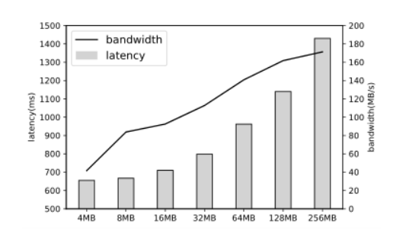
Motivation
Chunk Size
Conclusion

Slide 17
Motivation
Data Layouts
Contiguous Layout
Stripe Layout

Slide 18
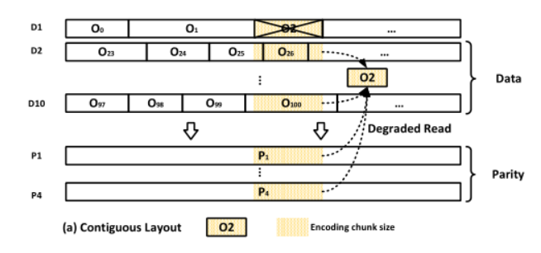
Motivation
Data Layouts
Contiguous Layout
read amplification

Slide 19
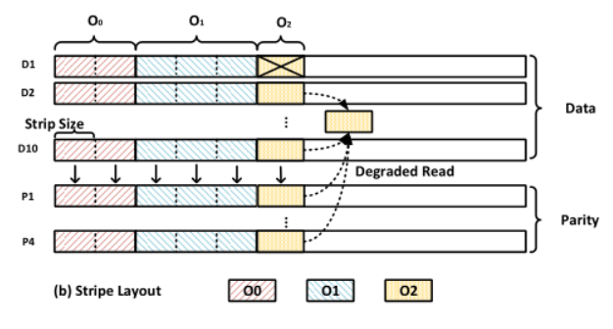
Motivation
Data Layouts
Stripe Layout
small chunk size is far from fully utilizing disk bandwidth

Slide 20
Motivation
Challenge
none of the existing layouts can achieve low degraded read time and high recovery efficiency simultaneously

Slide 21
Outline
1
Background
2
Motivation
3
Design
4
Evaluation
3
5
Conclusion

Slide 22
Design
Idea
Fixed chunk size
cannot utilize regenerating codes well
chunks with variable sizes
larger chunks to achieve efficient sequential reads
smaller chunks to reduce degraded read time through pipelining

Slide 23
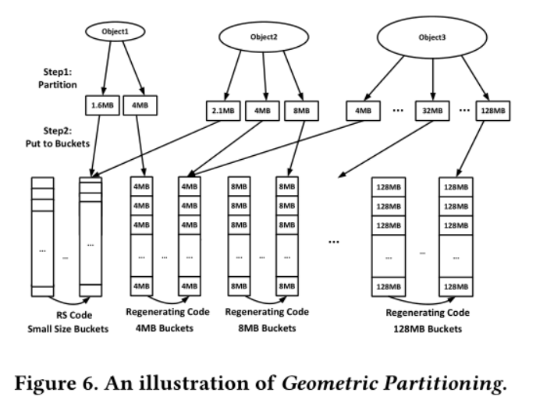
Design

Slide 24
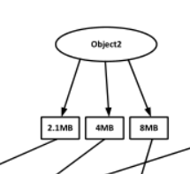
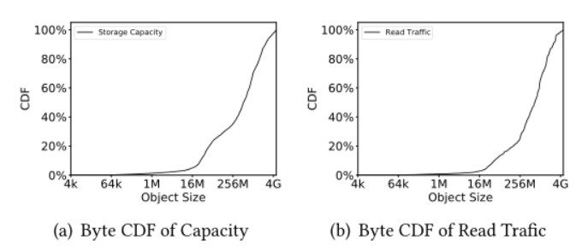

Design
Cut Front
Small-size-buckets
RS
4MB+(>97.7%)

Slide 25
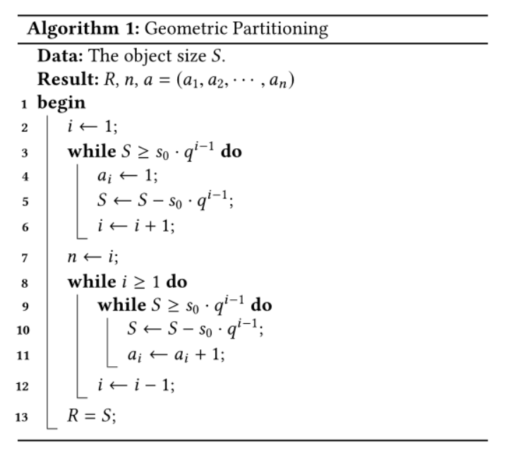
Design
Help Pipelining
a_{i} is non-zero
20MB=4MB+16MB
20MB=8MB+8MB+4MB

Slide 26
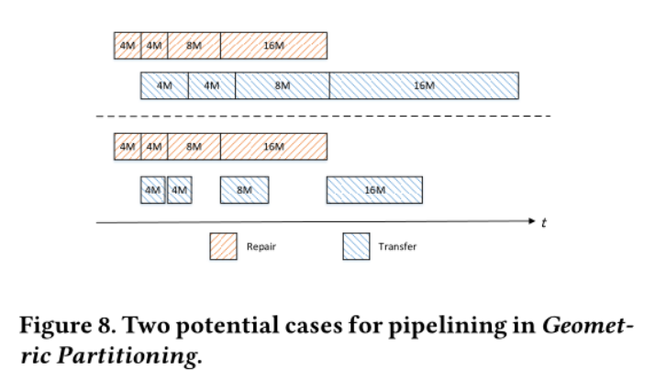
Design
Parameter Setting
s₀
q

Slide 27
Implementation
System Design
Architecture
Placement Groups

Slide 28
Implementation
Architecture
Directory Server
store meta information and monitor the whole system
Storage Server
store and manage the objects and also store index files to track objects. Each Storage Serveris bound to a specific disk.
HTTP Server
handle user requests

Slide 29
Implementation
Placement Groups
each PG
a group of k+r=14 disks on 14 different nodes
information about PGs
stored on Directory Servers
Each disk can belong to multiple PGs
Store
mapped to a PG
Choose disk
least capacity consumed
put into its corresponding buckets

Slide 30
Implementation
22.3GB/s for encoding
18.5GB/s for decoding
5.0GB/s for regenerating using multiple threads on a 12-core server for Clay(10,4) code

Slide 31
Outline
1
Background
2
Motivation
3
Design & Implementation
4
Evaluation
3
5
Conclusion

Slide 32
Evaluation
16 servers
dual Intel Xeon E5 2643 v4 CPU
128GB 2133 MHZ DDR4 RAM
512GB SATA3 SSD
6×8TB 7200rpm SAS HDD
56Gbps Infiniband network
HTTP server and a Storage Server
All servers
Directory Server.
three servers
Clients
on the same machine
Each machine runs at most 8 clients
1Gbps

Slide 33
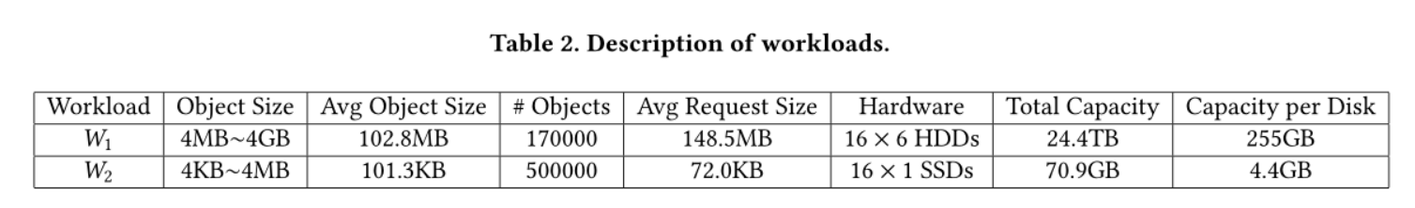
Evaluation
Workload
HDD(w1)
SSD(w2)

Slide 34
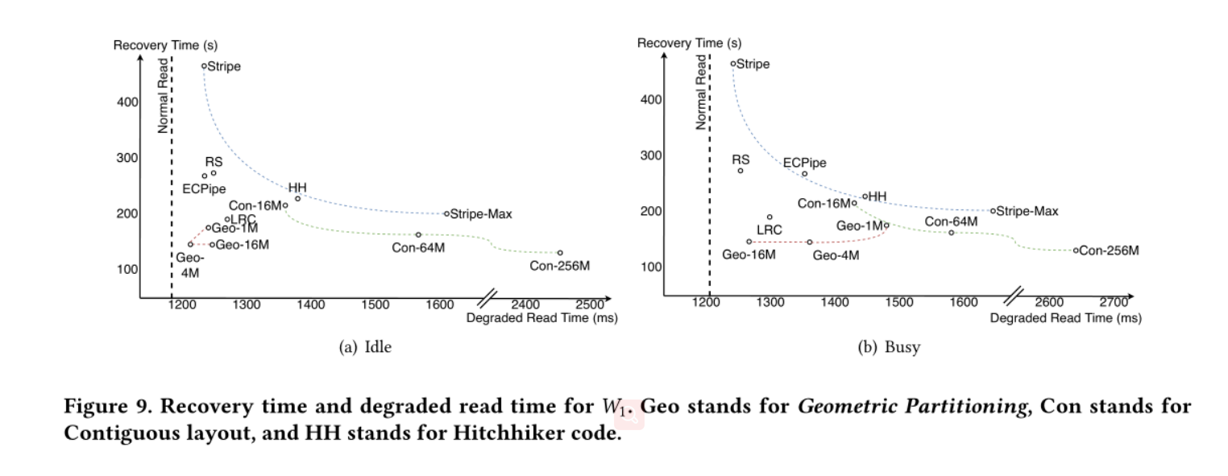
Evaluation
Degraded Read Time and Recovery Time

Slide 35
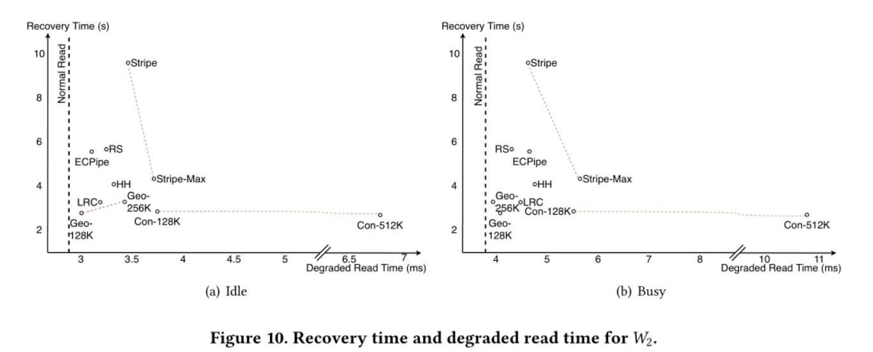
Evaluation
Degraded Read Time and Recovery Time

Slide 36
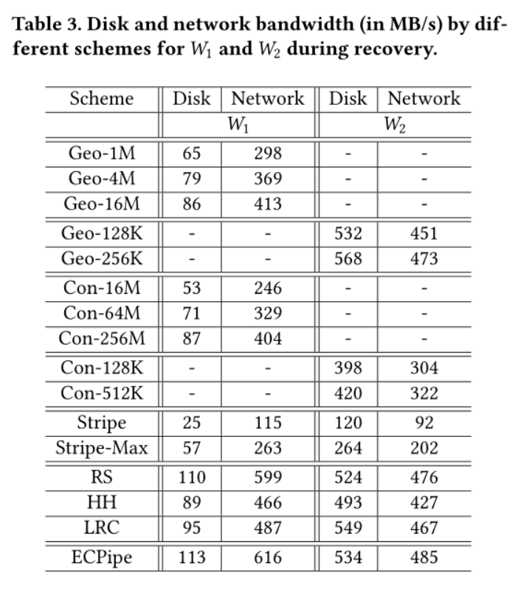
Evaluation

Slide 37
Outline
1
Background
2
Motivation
3
Design
4
Evaluation
3
5
Conclusion

Slide 38
Conclution
geometric partitioning
We validate its advantages experimentally using real-world traces.

Slide 39
THANK YOU

